Slide 1
Tutorial: Real time big data handling
CFSA Seminar, University of Warwick, 19 February 2019
Aleksandr kolotkov
Penza, Russia
Email: alexanderkolotkov@gmail.com

Slide 2
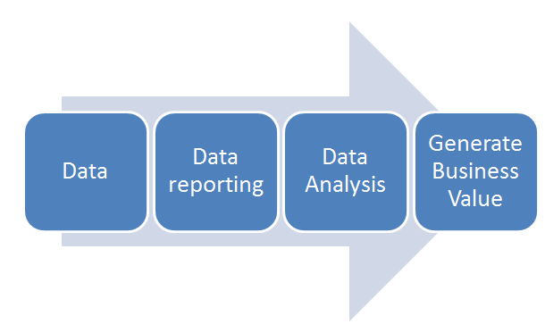
Process of data handling
Raw data collecting – choosing meaningful event parameters and storing them in a separate row for each event; at this stage we do not have to know exactly which dependencies and between which parameters will be further analyzed
Data reporting – the tool for aggregation and filtration collected raw data, as well as for searching for dependencies between parameters
Data analysis – the process of obtaining new knowledge, hypotheses testing and discovering dependencies between parameters using reporting
Dealing with new trends and insights we received after the data analysis

Slide 3
Raw data collecting
id | buyer | dt
1 | buyer_seo | 2017-07-01 00:00:01
2 | buyer_seo2 | 2017-07-01 00:00:01
3 | getter | 2017-07-01 00:00:03
4 | getter | 2017-07-01 00:00:04
5 | getter | 2017-07-01 00:00:05
6 | buyer_seo2 | 2017-07-01 00:01:16
7 | buyer_seo2 | 2017-07-01 00:01:17
8 | buyer_seo | 2017-07-01 00:11:20
9 | buyer_seo | 2017-07-01 00:11:55
10 | buyer_seo | 2017-07-01 00:15:22
11 | buyer_seo2 | 2017-07-01 00:10:01

Slide 4
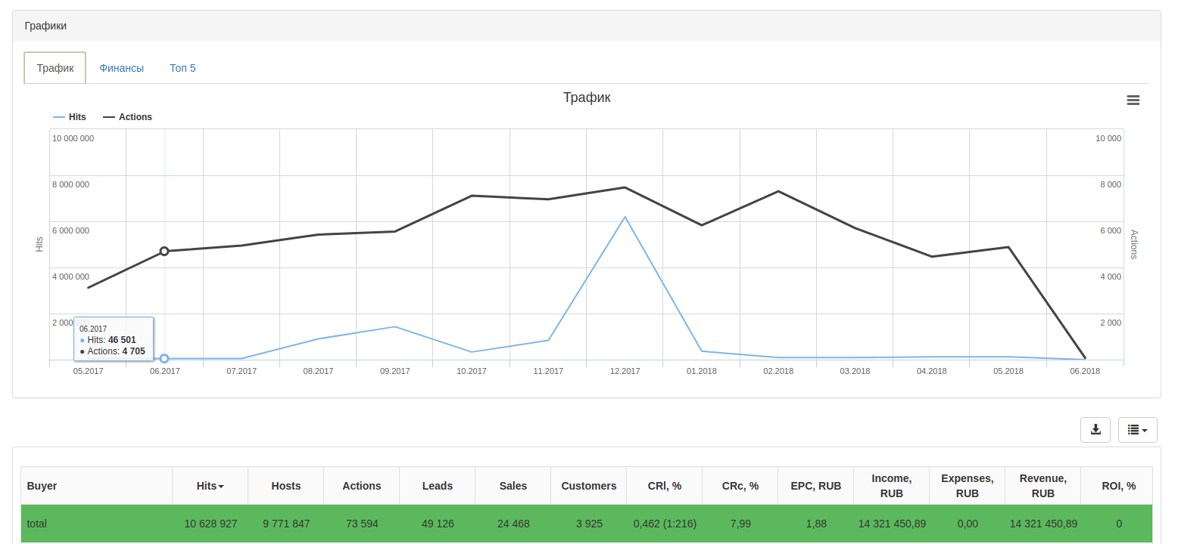
Reporting: detecting unusual behavior in data
Internet Traffic
# of requests to server (hits)
Time, months

Slide 5
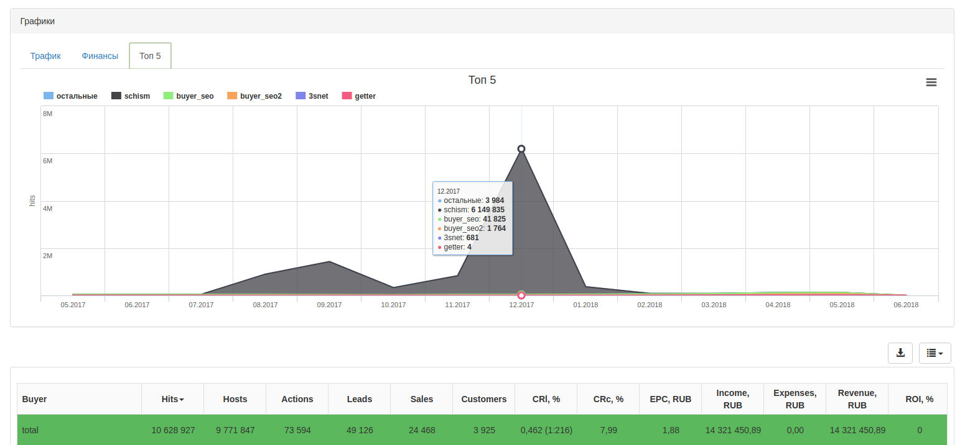
Analytics: hypothesis testing
Top 5 buyers
# of requests to server (hits)
Time, months

Slide 6

Reasonable computational resources
Adequate time-scales needed for the report making
And thus fast hypothesis testing

Slide 7

…is an open source column-oriented database management system capable of real time generation of analytical data reports using SQL queries.
Why ClickHouse?
Simple and handy
Highly reliable
Blazing fast
Hardware efficient
Fault tolerant
Linearly scalable
Feature reach
https://clickhouse.yandex/

Slide 8

All one need to know to start with ClickHouse in a nutshell...
Here's the command to check if your CPU is suitable (we will use Intel Core i7):
ClickHouse can run on any Linux, FreeBSD or Mac OS X (we will use Docker container with Linux on host computer with Mac OS X)
Docker - a computer program that performs operating-system-level virtualization. Docker installation documentation: https://www.docker.com/get-started ClickHouse Server Docker Image: https://hub.docker.com/r/yandex/clickhouse-server/
Tabix - visual interface for ClickHouse allowing one to perform data querying in web browser. Documentation link: https://github.com/tabixio/tabix
User-friendly SQL dialect for data querying: https://en.wikipedia.org/wiki/SQL
A sample dataset. We will use the USA civil flights data since 1987 till 2015 from the open sources (contains 166 millions rows, 63 Gb of uncompressed data) Download link: https://yadi.sk/d/pOZxpa42sDdgm

Slide 9
Sample dataset file format
Origin City Market ID
Origin Airport Seq ID
Origin Airport ID
Origin City Name
Origin State Name
Day of Month
Unique Carrier
Flight Number
Origin State Fips
Day of Week
Flight Date
Tail Number
Origin State
Quarter
Airline ID
Year
Month
Carrier
Origin
1987,4,10,19,1,1987-10-19,"CO",19704,"CO","","597",10821,1082102,30852,"BWI","Baltimore, MD","MD","24","Maryland", ...
1987,4,10,20,2,1987-10-20,"CO",19704,"CO","","597",10821,1082102,30852,"BWI","Baltimore, MD","MD","24","Maryland", ...
1987,4,10,21,3,1987-10-21,"CO",19704,"CO","","597",10821,1082102,30852,"BWI","Baltimore, MD","MD","24","Maryland", ...
1987,4,10,22,4,1987-10-22,"CO",19704,"CO","","597",10821,1082102,30852,"BWI","Baltimore, MD","MD","24","Maryland", ...
1987,4,10,23,5,1987-10-23,"CO",19704,"CO","","597",10821,1082102,30852,"BWI","Baltimore, MD","MD","24","Maryland", ...
1987,4,10,24,6,1987-10-24,"CO",19704,"CO","","597",10821,1082102,30852,"BWI","Baltimore, MD","MD","24","Maryland", ...
1987,4,10,25,7,1987-10-25,"CO",19704,"CO","","597",10821,1082102,30852,"BWI","Baltimore, MD","MD","24","Maryland", ...
1987,4,10,26,1,1987-10-26,"CO",19704,"CO","","597",10821,1082102,30852,"BWI","Baltimore, MD","MD","24","Maryland", ...
1987,4,10,27,2,1987-10-27,"CO",19704,"CO","","597",10821,1082102,30852,"BWI","Baltimore, MD","MD","24","Maryland", ...
1987,4,10,28,3,1987-10-28,"CO",19704,"CO","","597",10821,1082102,30852,"BWI","Baltimore, MD","MD","24","Maryland", ...
1987,4,10,29,4,1987-10-29,"CO",19704,"CO","","597",10821,1082102,30852,"BWI","Baltimore, MD","MD","24","Maryland", ...
1987,4,10,30,5,1987-10-30,"CO",19704,"CO","","597",10821,1082102,30852,"BWI","Baltimore, MD","MD","24","Maryland", ...
1987,4,10,31,6,1987-10-31,"CO",19704,"CO","","597",10821,1082102,30852,"BWI","Baltimore, MD","MD","24","Maryland", ...
1987,4,10,1,4,1987-10-01,"CO",19704,"CO","","598",12266,1226601,31453,"IAH","Houston, TX","TX","48","Texas", ...
1987,4,10,2,5,1987-10-02,"CO",19704,"CO","","598",12266,1226601,31453,"IAH","Houston, TX","TX","48","Texas", ...

Slide 10
Create table for sample dataset in ClickHouse
:) CREATE TABLE ontime
(
Year UInt16,
Quarter UInt8,
Month UInt8,
DayofMonth UInt8,
DayOfWeek UInt8,
FlightDate Date,
UniqueCarrier FixedString(7),
AirlineID Int32,
Carrier FixedString(2),
TailNum String,
FlightNum String,
OriginAirportID Int32,
OriginAirportSeqID Int32,
OriginCityMarketID Int32,
Origin FixedString(5),
OriginCityName String,
OriginState FixedString(2),
OriginStateFips String,
OriginStateName String,
...
)
ENGINE = MergeTree(FlightDate, (Year, FlightDate), 8192);

Slide 11

Questions we will try to answer (obtain new knowledge):
the most popular destinations in 2015;
the most popular cities of departure;
cities of departure which offer maximum variety of destinations;
flight delay dependence on the day of week;
cities of departure with most frequent delays for 1 hour or longer;
flights of maximum duration;
distribution of arrival time delays split by aircompanies;
aircompanies who stopped flights operation;
most trending destination cities in 2015;
destination cities with maximum popularity-season dependency.

Slide 12

Pros and cons of using ClickHouse on your own computer
Pros
It is absolutely possible
It allows not only store big data sets on your hard drive in a compact form but it provides you real-time access to any part of that data
It is really fast in data aggregation and filtration
You should not be database administrator or any other kind of technical specialist to start using it
It has excellent and detailed documentation
Cons
It requires some preparations of data before loading to database
To be able use it in a more efficient way you still have to learn a little something new

Slide 13
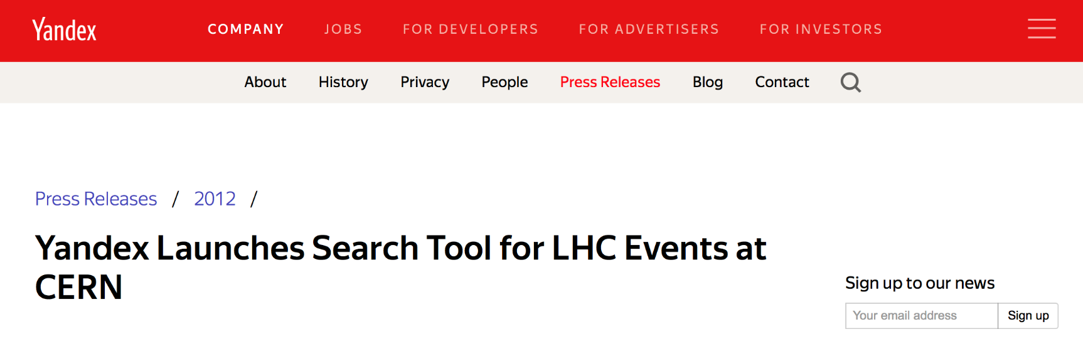
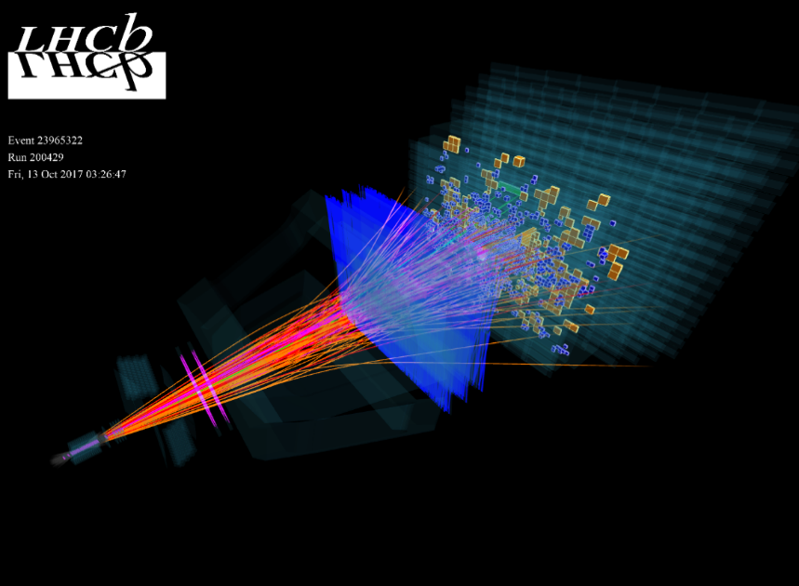
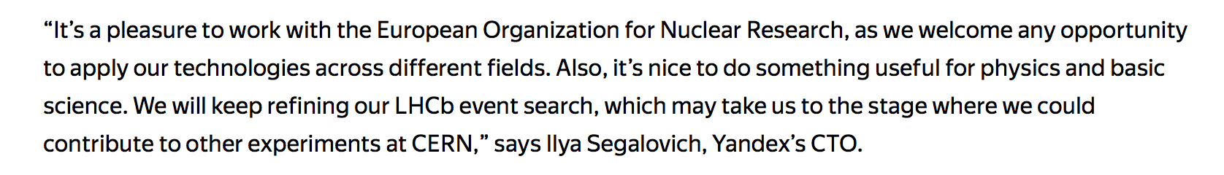
ClickHouse has already been successfully implemented at CERN's LHCb experiment to store and process metadata on 10 billion events with over 1000 attributes per event.
https://www.yandex.com/company/press_center/press_releases/2012/2012-04-10/

Slide 14

From business intelligence to solar and space climate data?
https://github.com/kolotkov/clickhouse-tutorial

